Slide 1
Arrays and Vectors
Sampath Jayarathna
Cal Poly Pomona
Based on slides created by Bjarne Stroustrup & Tony Gaddis

Slide 2
Arrays Hold Multiple Values
Array: variable that can store multiple values of the same type
Values are stored in adjacent memory locations
Declared using [] operator:
int tests[5];

Slide 3
Array - Memory Layout
The definition:
int tests[5];
allocates the following memory:
first element | second element | third element | fourth element | fifth element

Slide 4
Array Terminology
In the definition int tests[5];
int is the data type of the array elements
tests is the name of the array
5, in [5], is the size declarator. It shows the number of elements in the array.
The size of an array is (number of elements) * (size of each element)

Slide 5
Array Terminology
The size of an array is:
the total number of bytes allocated for it
(number of elements) * (number of bytes for each element)
Examples:
int tests[5] is an array of 20 bytes, assuming 4 bytes for an int
long double measures[10]is an array of 80 bytes, assuming 8 bytes for a long double

Slide 6
Size Declarators
Named constants are commonly used as size declarators. const int SIZE = 5; int tests[SIZE];
This eases program maintenance when the size of the array needs to be changed.

Slide 7
Accessing Array Elements
Each element in an array is assigned a unique subscript.
Subscripts start at 0
subscripts:
0 | 1 | 2 | 3 | 4

Slide 8
Accessing Array Elements
The last element’s subscript is n-1 where n is the number of elements in the array.
subscripts:
0 | 1 | 2 | 3 | 4

Slide 9
Accessing Array Elements
Array elements can be used as regular variables:
tests[0] = 79;
cout << tests[0];
cin >> tests[1];
tests[4] = tests[0] + tests[1];
Arrays must be accessed via individual elements:
cout << tests; // not legal

Slide 10
Accessing Array Contents
Can access element with a constant or literal subscript:
cout << tests[3] << endl;
Can use integer expression as subscript:
int i = 5;
cout << tests[i] << endl;

Slide 11
Using a Loop to Step Through an Array
Example – The following code defines an array, numbers, and assigns 99 to each element:
const int ARRAY_SIZE = 5;
int numbers[ARRAY_SIZE];
for (int count = 0; count < ARRAY_SIZE; count++)
numbers[count] = 99;

Slide 12
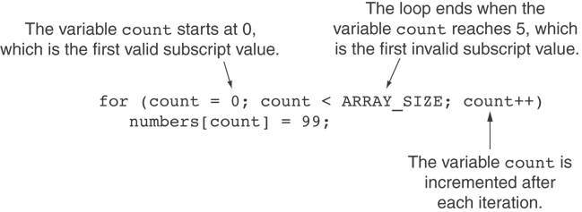
A Closer Look At the Loop

Slide 13
Activity 13
Create an integer array of size 3 called hours. ARRAY_SIZE is a constant of value 3.
Get hours for 3 employees and add the data to array and display the hours.
Modify the above code to have a for loop to collect hours for 6 employees.
Display the array data using a loop.

Slide 14
No Bounds Checking in C++
When you use a value as an array subscript, C++ does not check it to make sure it is a valid subscript.
In other words, you can use subscripts that are beyond the bounds of the array.

Slide 15
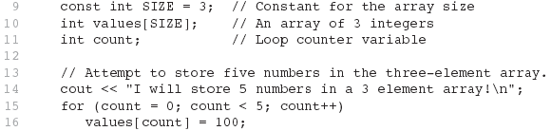
Code From Program 7-5
The following code defines a three-element array, and then writes five values to it!

Slide 16
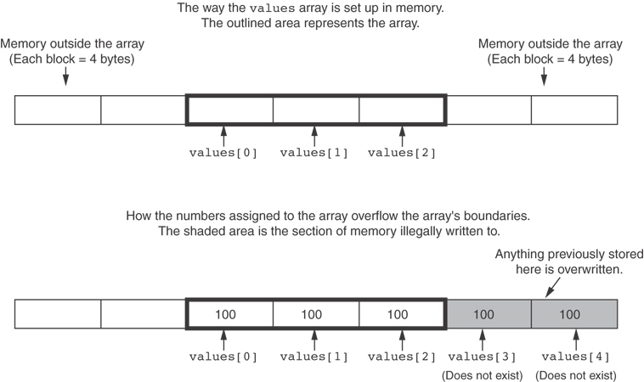
What the Code Does

Slide 17
No Bounds Checking in C++
Be careful not to use invalid subscripts.
Doing so can corrupt other memory locations, crash program, or lock up computer, and cause elusive bugs.

Slide 18
Off-By-One Errors
An off-by-one error happens when you use array subscripts that are off by one.
This can happen when you start subscripts at 1 rather than 0:
// This code has an off-by-one error.
const int SIZE = 100;
int numbers[SIZE];
for (int count = 1; count <= SIZE; count++)
numbers[count] = 0;

Slide 19
Array Initialization
Arrays can be initialized with an initialization list: const int SIZE = 5; int tests[SIZE] = {79,82,91,77,84};
The values are stored in the array in the order in which they appear in the list.
The initialization list cannot exceed the array size.

Slide 20
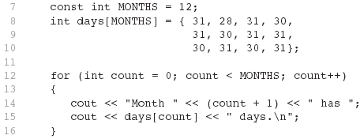
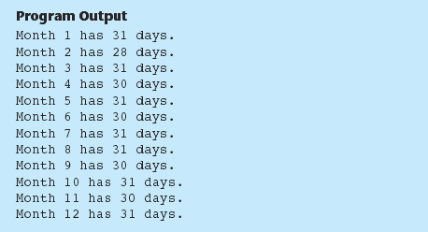
Code From Program 7-6

Slide 21
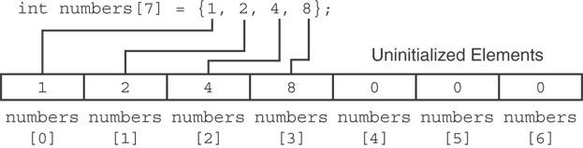
Partial Array Initialization
If array is initialized with fewer initial values than the size declarator, the remaining elements will be set to 0:

Slide 22
Implicit Array Sizing
Can determine array size by the size of the initialization list:
int quizzes[]={12,17,15,11};
Must use either array size declarator or initialization list at array definition
12 | 17 | 15 | 11

Slide 23
The Range-Based for Loop
C++ 11 provides a specialized version of the for loop that, in many circumstances, simplifies array processing.
The range-based for loop is a loop that iterates once for each element in an array.
Each time the loop iterates, it copies an element from the array to a built-in variable, known as the range variable.
The range-based for loop automatically knows the number of elements in an array.
You do not have to use a counter variable.
You do not have to worry about stepping outside the bounds of the array.

Slide 24
The Range-Based for Loop
Here is the general format of the range-based for loop:
dataType is the data type of the range variable.
rangeVariable is the name of the range variable. This variable will receive the value of a different array element during each loop iteration.
array is the name of an array on which you wish the loop to operate.
statement is a statement that executes during a loop iteration. If you need to execute more than one statement in the loop, enclose the statements in a set of braces.
for (dataType rangeVariable : array)
statement;

Slide 25
The range-based for loop in Program 7-10
// This program demonstrates the range-based for loop. #include <iostream> using namespace std; int main() { // Define an array of integers. int numbers[] = { 10, 20, 30, 40, 50 }; // Display the values in the array. for (int val : numbers) cout << val << endl; return 0; }

Slide 26
The Range-Based for Loop versus the Regular for Loop
The range-based for loop can be used in any situation where you need to step through the elements of an array, and you do not need to use the element subscripts.
If you need the element subscript for some purpose, use the regular for loop.

Slide 27
Processing Array Contents
Array elements can be treated as ordinary variables of the same type as the array
When using ++, -- operators, don’t confuse the element with the subscript:
tests[i]++; // add 1 to tests[i]
tests[i++]; // increment i, no
// effect on tests

Slide 28
Array Assignment
To copy one array to another,
Don’t try to assign one array to the other:
newTests = tests; // Won't work
Instead, assign element-by-element:
for (i = 0; i < ARRAY_SIZE; i++)
newTests[i] = tests[i];

Slide 29
Printing the Contents of an Array
You can display the contents of a character array by sending its name to cout: char fName[] = "Henry";
cout << fName << endl;
But, this ONLY works with character arrays!

Slide 30
Printing the Contents of an Array
For other types of arrays, you must print element-by-element:
for (i = 0; i < ARRAY_SIZE; i++)
cout << tests[i] << endl;

Slide 31
Printing the Contents of an Array
In C++ 11 you can use the range-based for loop to display an array's contents, as shown here:
for (int val : numbers)
cout << val << endl;

Slide 32
Summing and Averaging Array Elements
Use a simple loop to add together array elements:
int tnum;
double average, sum = 0;
for(tnum = 0; tnum < SIZE; tnum++)
sum += tests[tnum];
Once summed, can compute average:
average = sum / SIZE;

Slide 33
Summing and Averaging Array Elements
In C++ 11 you can use the range-based for loop, as shown here:
double total = 0; // Initialize accumulator
double average; // Will hold the average
for (int val : scores)
total += val;
average = total / NUM_SCORES;

Slide 34
Finding the Highest Value in an Array
int count;
int highest;
highest = numbers[0];
for (count = 1; count < SIZE; count++)
{
if (numbers[count] > highest)
highest = numbers[count];
}
When this code is finished, the highest variable will contains the highest value in the numbers array.

Slide 35
Finding the Lowest Value in an Array
int count;
int lowest;
lowest = numbers[0];
for (count = 1; count < SIZE; count++)
{
if (numbers[count] < lowest)
lowest = numbers[count];
}
When this code is finished, the lowest variable will contains the lowest value in the numbers array.

Slide 36
Activity 14
Finding the Highest Value and the Lowest value of the following array.
Also find the sum of the array elements and the average.
Modify your code to get a user input and search the particular number received from the user in the array. Display appropriate message when you locate the item from the array.
int[]days = {16, 28, 12, 30, 11, 5, 21, 6, 23, 3, 7, 31};

Slide 37
Partially-Filled Arrays
If it is unknown how much data an array will be holding:
Make the array large enough to hold the largest expected number of elements.
Use a counter variable to keep track of the number of items stored in the array.

Slide 38
Comparing Arrays
To compare two arrays, you must compare element-by-element:
const int SIZE = 5;
int firstArray[SIZE] = { 5, 10, 15, 20, 25 };
int secondArray[SIZE] = { 5, 10, 15, 20, 25 };
bool arraysEqual = true; // Flag variable
int count = 0; // Loop counter variable
// Compare the two arrays.
while (arraysEqual && count < SIZE)
{
if (firstArray[count] != secondArray[count])
arraysEqual = false;
count++;
}
if (arraysEqual)
cout << "The arrays are equal.\n";
else
cout << "The arrays are not equal.\n";

Slide 39
Using Parallel Arrays
Parallel arrays: two or more arrays that contain related data
A subscript is used to relate arrays: elements at same subscript are related
Arrays may be of different types

Slide 40
Parallel Array Example
const int SIZE = 5; // Array size
int id[SIZE]; // student ID
double average[SIZE]; // course average
char grade[SIZE]; // course grade
...
for(int i = 0; i < SIZE; i++) {
cout << "Student ID: " << id[i]
<< " average: " << average[i]
<< " grade: " << grade[i]
<< endl; }

Slide 41
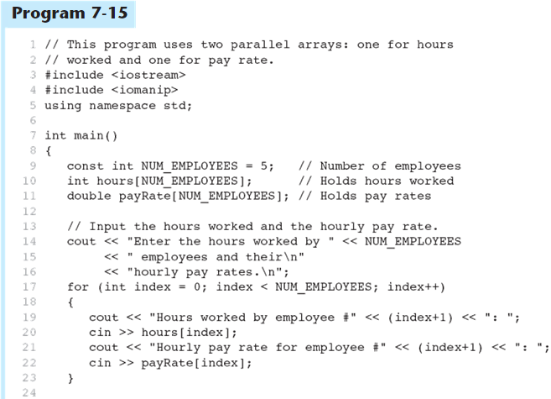
Parallel Arrays in Program 7-15
(Program Continues)

Slide 42
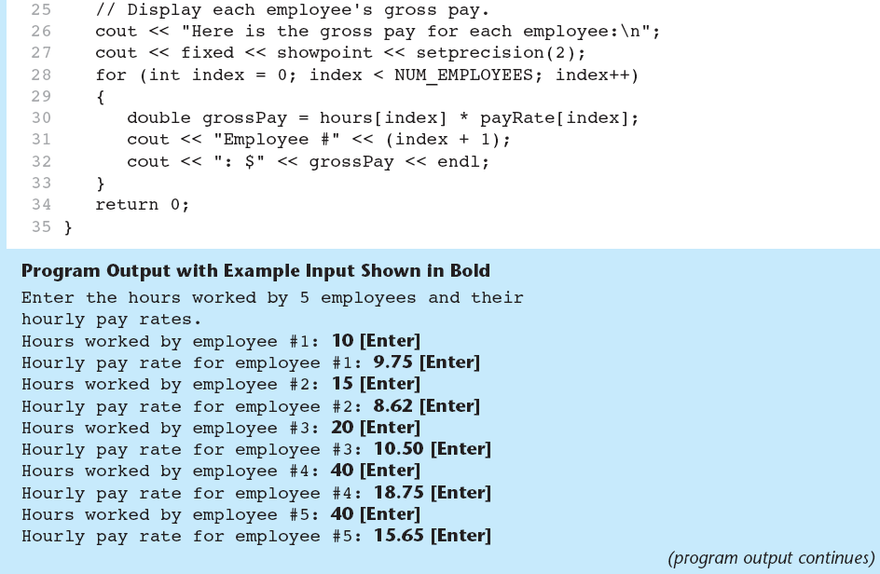
Parallel Arrays in Program 7-15

Slide 43
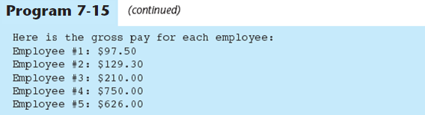
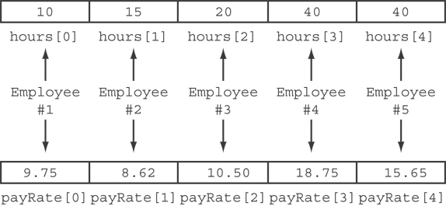
Parallel Arrays in Program 7-15
The hours and payRate arrays are related through their subscripts:

Slide 44
Two-Dimensional Arrays
Can define one array for multiple sets of data
Like a table in a spreadsheet
Use two size declarators in definition:
const int ROWS = 4, COLS = 3; int exams[ROWS][COLS];
First declarator is number of rows; second is number of columns

Slide 45
Two-Dimensional Array Representation
const int ROWS = 4, COLS = 3; int exams[ROWS][COLS];
Use two subscripts to access element:
exams[2][2] = 86;
columns
exams[0][0] | exams[0][1] | exams[0][2]
exams[1][0] | exams[1][1] | exams[1][2]
exams[2][0] | exams[2][1] | exams[2][2]
exams[3][0] | exams[3][1] | exams[3][2]
r
o
w
s

Slide 46
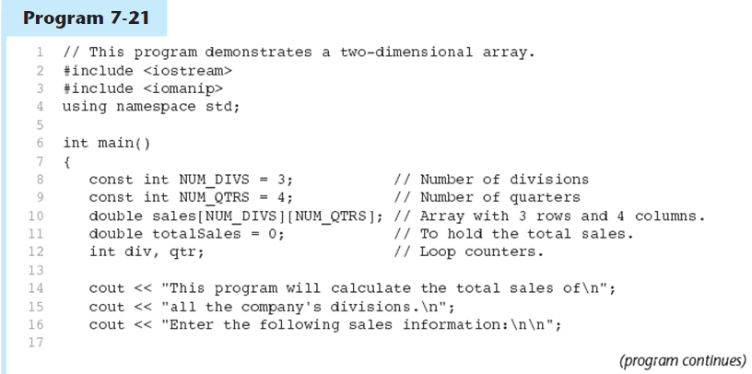
A Two-dimensional Array in Program 7-21

Slide 47
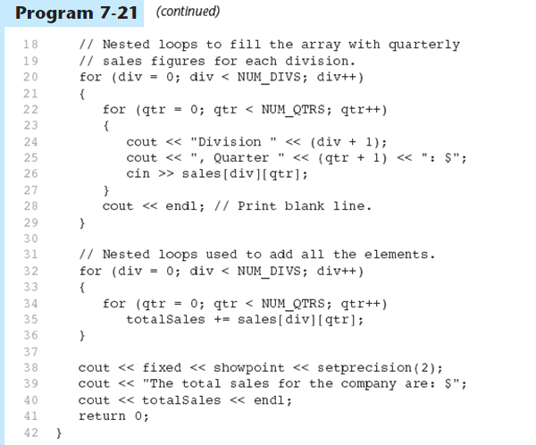
A Two-dimensional Array in Program 7-21

Slide 48
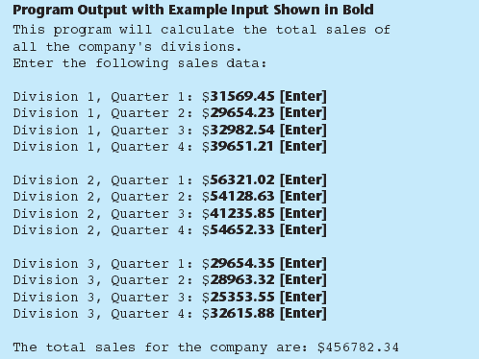
A Two-dimensional Array in Program 7-21

Slide 49
2D Array Initialization
Two-dimensional arrays are initialized row-by-row: const int ROWS = 2, COLS = 2; int exams[ROWS][COLS] = { {84, 78},
{92, 97} };
Can omit inner { }, some initial values in a row – array elements without initial values will be set to 0 or NULL
84 | 78
92 | 97

Slide 50
Summing All the Elements in a Two-Dimensional Array
Given the following definitions:
const int NUM_ROWS = 5; // Number of rows
const int NUM_COLS = 5; // Number of columns
int total = 0; // Accumulator
int numbers[NUM_ROWS][NUM_COLS] =
{{2, 7, 9, 6, 4},
{6, 1, 8, 9, 4},
{4, 3, 7, 2, 9},
{9, 9, 0, 3, 1},
{6, 2, 7, 4, 1}};

Slide 51
Summing All the Elements in a Two-Dimensional Array
// Sum the array elements.
for (int row = 0; row < NUM_ROWS; row++)
{
for (int col = 0; col < NUM_COLS; col++)
total += numbers[row][col];
}
// Display the sum.
cout << "The total is " << total << endl;

Slide 52
Introduction to the STL vector
A data type defined in the Standard Template Library
Can hold values of any type:
vector<int> scores;
Automatically adds space as more is needed – no need to determine size at definition
Can use [] to access elements

Slide 53
Declaring Vectors
You must #include<vector>
Declare a vector to hold int element:
vector<int> scores;
Declare a vector with initial size 30:
vector<int> scores(30);
Declare a vector and initialize all elements to 0:
vector<int> scores(30, 0);
Declare a vector initialized to size and contents of another vector:
vector<int> finals(scores);

Slide 54
Adding Elements to a Vector
If you are using C++ 11, you can initialize a vector with a list of values:
vector<int> numbers { 10, 20, 30, 40 };
Use push_back member function to add element to a full array or to an array that had no defined size:
scores.push_back(75);
Use size member function to determine size of a vector:
howbig = scores.size();

Slide 55
Removing Vector Elements
Use pop_back member function to remove last element from vector:
scores.pop_back();
To remove all contents of vector, use clear member function:
scores.clear();
To determine if vector is empty, use empty member function:
while (!scores.empty()) ...

Slide 56
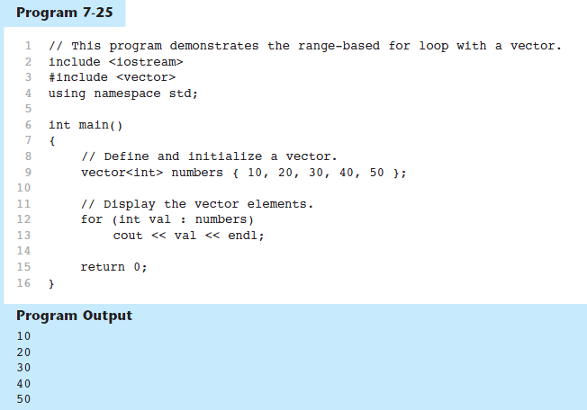
Using the Range-Based for Loop with a vector in C++ 11

Slide 57
Other Useful Member Functions
Member Function | Description | Example
at(elt) | Returns the value of the element at position elt in the vector | cout << vec1.at(i);
capacity() | Returns the maximum number of elements a vector can store without allocating more memory | maxelts = vec1.capacity();
reverse() | Reverse the order of the elements in a vector | vec1.reverse();
resize (elts,val) | Add elements to a vector, optionally initializes them | vec1.resize(5,0);
swap(vec2) | Exchange the contents of two vectors | vec1.swap(vec2);

Slide 58
Activity 15
Create an Vector of Integer called randoms and generate 50 random values in the range 1-100 to store in the Vector
Use rand() %100 to generate values in the range of 0-99
Display the values of the randoms
Sort the vector values using sort(randoms.begin(), randoms.end())
Need to include <algorithm> header
Display the values of the randoms after sort.

